Slide 1

Estimating Value Functions as Supervised Learning
Notes:
1

Slide 2
Objectives
Understand how we can use parameterized functions to approximate values
Understand what is meant by generalization and discrimination
Understand how supervised learning methods can be useful for handling parts of the reinforcement learning problem
Estimating Value Functions
2
Notes:
2

Slide 3
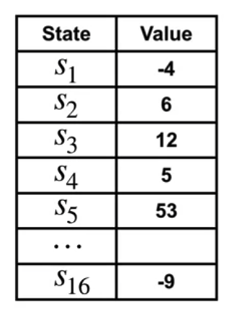
Parameterized Functions
A value function can be represented in many different ways
For each state, we store separate value in a table.
We look at values, and modify them in the table as learning progresses.
Estimating Value Functions
3
Notes:
3

Slide 4
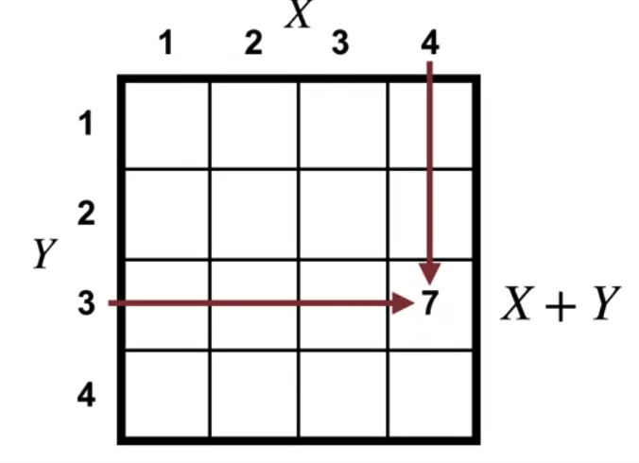
Parameterized Functions
A value function can be represented in many different ways
we can use any function that takes a state, and produces a real number.
For example in a grid like this, our value function approximation could take the X and Y position, and add them together to produce a value estimate.
Estimating Value Functions
4
Notes:
4

Slide 5
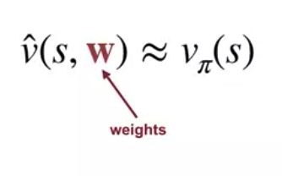
Parameterized Functions
In both ways, we can't modify the approximation.
→ We incorporate a set of real valued weights, which we can adjust to change the function.
Estimating Value Functions
5
Notes:
5

Slide 6
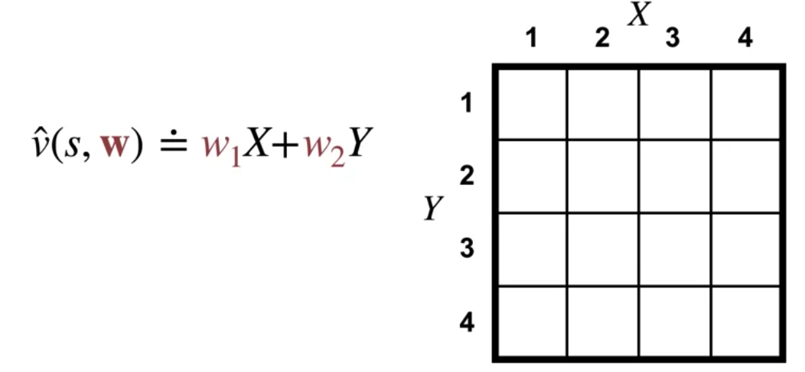
Parameterized Functions
Example
In this grid, instead of using a fixed sum of X and Y, we could use a function of the form w-1 times X, plus w-2 times Y.
The weights w-1 and w-2 parameterize our function.
Estimating Value Functions
6
Notes:
6

Slide 7
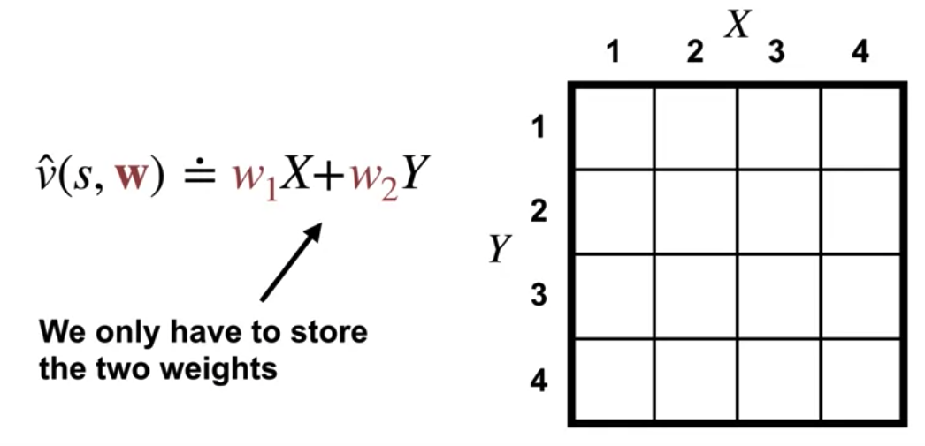
Parameterized Functions
Example
They allow us to change the output the function generates. v hat is a function approximate the true value function
W is a vector containing all the weights that parameterize the approximation.
We do not have to store a whole table of values
Estimating Value Functions
7
Notes:
7

Slide 8
Linear Value Function Approximation
Linear value function approximation is a technique used in reinforcement learning (RL) to approximate the value function using a linear combination of features.
It is commonly employed in situations where the state space is large or continuous, making it impractical to represent the value function explicitly for every state.
Estimating Value Functions
8
Notes:
8

Slide 9
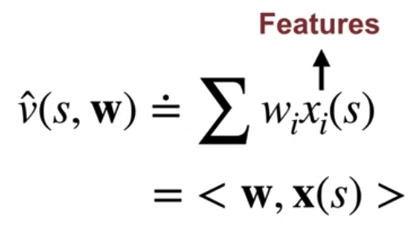
Linear Value Function Approximation
The value of each state, is computed as the sum of the weights multiplied by some fixed attributes of the state called features.
We write that the approximate value is given by the inner product of this feature vector, and the weight vector. We will use bold X of S to denote the feature vector.
Estimating Value Functions
9
Notes:
9

Slide 10
Linear Value Function Approximation
Limitations:
Linearity Assumption: Linear value function approximation assumes that the relationship between the features and the value function is linear.
Limited Expressiveness: Linear value function approximation may not be expressive enough to capture complex relationships between states and values.
Estimating Value Functions
10
Notes:
10

Slide 11
Linear Value Function Approximation
Limitations:
Feature Engineering Dependency: The performance of linear value function approximation heavily depends on the quality of the features chosen for representation.
Curse of Dimensionality: Linear value function approximation may suffer from the curse of dimensionality when dealing with high-dimensional state spaces.
Estimating Value Functions
11
Notes:
11

Slide 12
Linear Value Function Approximation
Limitations:
Difficulty with Function Approximation: Linear value function approximation may struggle to approximate highly nonlinear value functions accurately.
Sensitivity to Noise: Linear value function approximation may be sensitive to noisy or irrelevant features, leading to overfitting or poor generalization performance.
Estimating Value Functions
12
Notes:
12

Slide 13
Generalization vs Discrimination
While generalization refers to the ability of a system to perform well on new, unseen data, discrimination involves unjust or prejudiced distinctions between individuals or groups based on certain characteristics.
While generalization is a desirable property in many contexts, discrimination is harmful and should be avoided.
Estimating Value Functions
13
Notes:
13

Slide 14
Generalization vs Discrimination
Definition:
Generalization refers to the ability of a system or model to perform accurately on new, unseen data that is similar to the data it was trained on.
Discrimination refers to the act of making unjust or prejudiced distinctions between individuals or groups based on certain characteristics such as race, gender, or ethnicity.
Estimating Value Functions
14
Notes:
14

Slide 15
Generalization vs Discrimination
Purpose:
The goal of generalization is to develop models or systems that can effectively generalize from training data to new, unseen data.
Discrimination has no legitimate purpose. It involves treating individuals unfairly based on arbitrary or irrelevant characteristics rather than their individual merits or actions.
Estimating Value Functions
15
Notes:
15

Slide 16
Generalization vs Discrimination
Outcome:
Successful generalization results in models that can accurately predict outcomes or make decisions on new, unseen data.
Discrimination, particularly in the negative sense, leads to unjust treatment and inequality.
Estimating Value Functions
16
Notes:
16

Slide 17
Generalization vs Discrimination
Evaluation:
Generalization is typically evaluated using metrics such as accuracy, precision, recall, or mean squared error on held-out test data.
Discrimination is evaluated based on whether individuals or groups are treated differently based on irrelevant characteristics such as race, gender, or ethnicity.
Estimating Value Functions
17
Notes:
17

Slide 18
Supervised Learning vs RL
While RL focuses on learning optimal policies through interaction with an environment
Supervised learning methods can be valuable tools for handling various aspects of the RL problem, including modeling complex environments, approximating value functions, learning policies, and leveraging prior knowledge.
Estimating Value Functions
18
Notes:
18

Slide 19
Supervised Learning vs RL
Supervised learning can complement RL in several ways:
Modeling: Supervised learning can be used to approximate complex or unknown aspects of the environment. For example, if the dynamics of the environment are unknown, a supervised learning model can be trained to predict state transitions or rewards based on observed data, allowing the RL agent to plan and make decisions more effectively.
Objective for On-policy Prediction
19
Notes:
19

Slide 20
Supervised Learning vs RL
Supervised learning can complement RL in several ways:
Value Function Approximation: Supervised learning methods can be used to approximate the value function in RL. By treating the value function as a target variable and using observed state-action pairs and their associated returns, supervised learning algorithms can learn to estimate the value function more efficiently than traditional RL methods.
Objective for On-policy Prediction
20
Notes:
20

Slide 21
Supervised Learning vs RL
Supervised learning can complement RL in several ways:
Policy Improvement: Supervised learning can be used to learn a policy directly from expert demonstrations or human feedback. This can be particularly useful in settings where expert knowledge is available but collecting reward signals from the environment is difficult or expensive.
Objective for On-policy Prediction
21
Notes:
21

Slide 22
Supervised Learning vs RL
Supervised learning can complement RL in several ways:
Function Approximation: Supervised learning techniques such as neural networks can be used to approximate complex functions involved in RL algorithms, such as Q-functions or policy functions. This allows for more flexible and scalable representations, especially in high-dimensional state and action spaces.
Estimating Value Functions
22
Notes:
22

Slide 23
Supervised Learning vs RL
Supervised learning can complement RL in several ways:
Transfer Learning: Supervised learning methods can leverage pre-trained models or features from related tasks to accelerate learning in RL. By transferring knowledge from one domain to another, RL agents can benefit from previously learned representations or policies, reducing the need for extensive exploration and training.
Estimating Value Functions
23
Notes:
23

Slide 24
Supervised Learning vs RL
Supervised learning can complement RL in several ways:
Data Augmentation: Supervised learning techniques can be used to augment the RL agent's experience by generating synthetic data or perturbing existing data. This can help improve the agent's robustness to variations in the environment and enhance its ability to generalize across different scenarios.
Estimating Value Functions
24
Notes:
24

Slide 25
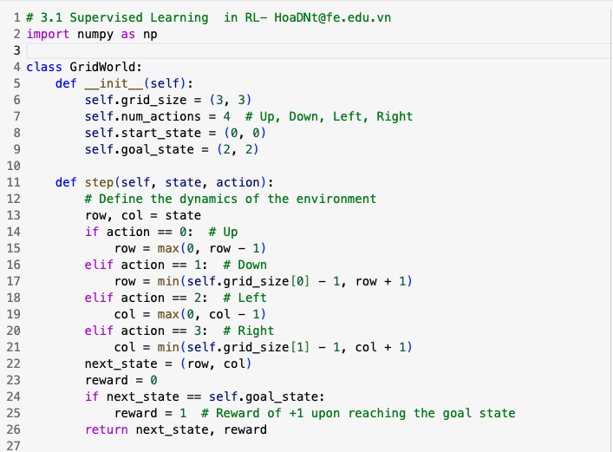
Supervised Learning in RL Example
The example of using supervised learning to learn a policy for a simple grid world environment.
Estimating Value Functions
25
Notes:
25

Slide 26
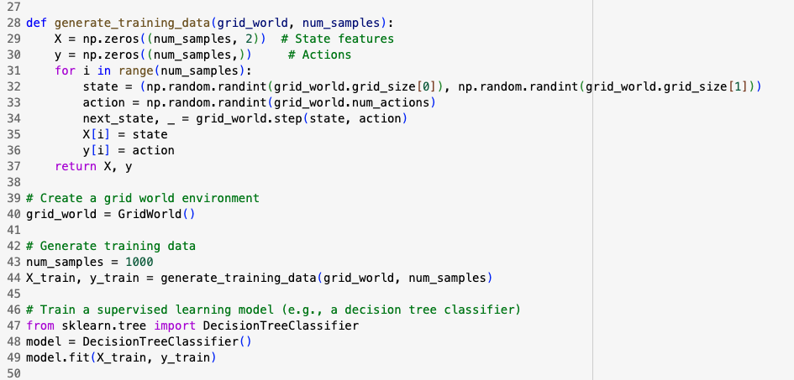
Supervised Learning in RL Example
Estimating Value Functions
26
Notes:
26

Slide 27
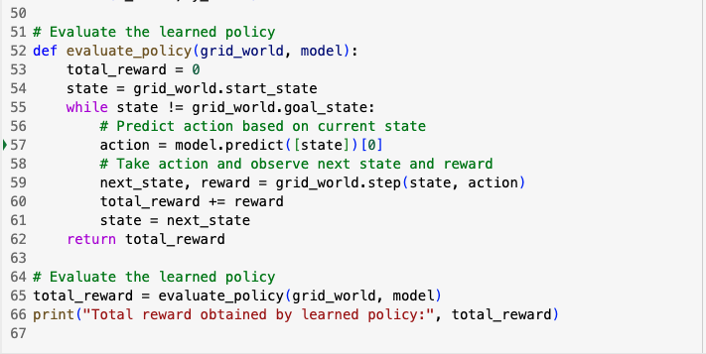
Supervised Learning in RL Example
Estimating Value Functions
27
Notes:
27

Slide 28
Supervised Learning in RL Example
Show your result after run that code
Estimating Value Functions
28
Notes:
28

Slide 29
Summary
Understand how we can use parameterized functions to approximate values
Understand what is meant by generalization and discrimination
Understand how supervised learning methods can be useful for handling parts of the reinforcement learning problem
Estimating Value Functions
29

Slide 30
Q & A
Estimating Value Functions
30

